Slide 1


DEVELOPMENT SCENARIOS AND A MAPPING TOOL TO PROTECT THE CONTESTED COUNTRYSIDE
A joint project of students in the Geomatics Institute at
Fleming College and the Ontario Headwaters Institute, 2022
September, 2022

Slide 2

INTRODUCTION 1 of 4 (Detailed notes in lieu of voice-over)
This slide deck is meant to inspire discussion about retaining an optimal amount of aquatic resources, natural heritage, and agricultural lands in the Contested Countryside, the area between existing municipal boundaries and the Greenbelt, as can be seen in the mapping found below.
While some of the Contested Countryside has been called the White Belt, the Ontario Headwaters Institute considers that such a label implies too broad an inclination in favour of inevitable urbanization.
We prefer the term the Contested Countryside - and a more open discussion about how much of it could and should be protected.
In that discussion, we are concerned that if the existing land development protocols that have given us the polluted water, fragmented forests, and extensively reduced farmland across much of South-central Ontario are extended to the Contested Countryside, it would severely impact the region’s ecological, social, and economic well-being.

Slide 3
INTRODUCTION 2 of 4
Proposed urban expansion into the Contested Countryside dominated regional discussion on draft official plans that municipalities across the Greater Golden Horseshoe were required to have submitted to the Province, for the most part by July 2, 2022.
While some municipalities focused on increasing density in existing areas, with modest urban expansion, others have sought massive land conversion of up to 10,000 acres. All draft plans are now under review by the Province.
While on one hand this process is almost complete, it will also kick off discussion of far greater detail.
What buffers will be used to protect water and wetlands? Which forests, meadows, and agricultural lands will be lost? Will sanitary sewage or its effluent harm our receiving waters? How will we pursue and implement sustainable planning?

Slide 4
INTRODUCTION 3 of 4
These are not irrelevant questions, especially as a high-level goal of the Planning Act is to “promote sustainable economic development in a healthy natural environment within a provincial policy framework”.
In addition, a key element in that framework can be found in the Provincial Policy Statement, which directs planning authorities to “protect, improve or restore the quality and quantity of water by: a) using the watershed as the ecologically meaningful scale for integrated and long-term planning...
Just because there may be new municipal boundaries is no excuse to not protect our water as well as our natural heritage and agricultural lands – that which sustains us.
And because we have a housing crisis, should we not take care to build sustainable communities, rather than under-serviced bedroom communities, in which people will want to live?

Slide 5
INTRODUCTION 4 of 4
Thanks to extensive work by students at Fleming College, we offer the three development scenarios described below, as well as links to the project’s mapping, as resources for municipalities, planners, developers, and civil society to use in site-specific discussions as new detailed planning begins to take shape.
For our part, the OHI has created COWA, the Coalition of Ontario Watershed Alliances, at www.cowa.ca, to “make watershed planning the basis of further land use development in Ontario, whether urban, rural, or remote, in order to protect our waters, natural heritage, and agricultural lands for a sustainable future.”
As we work on that front, we hope that the Contested Countryside scenarios and its maps will be helpful to those engaged in local land development discussions across South-central Ontario.

Slide 6
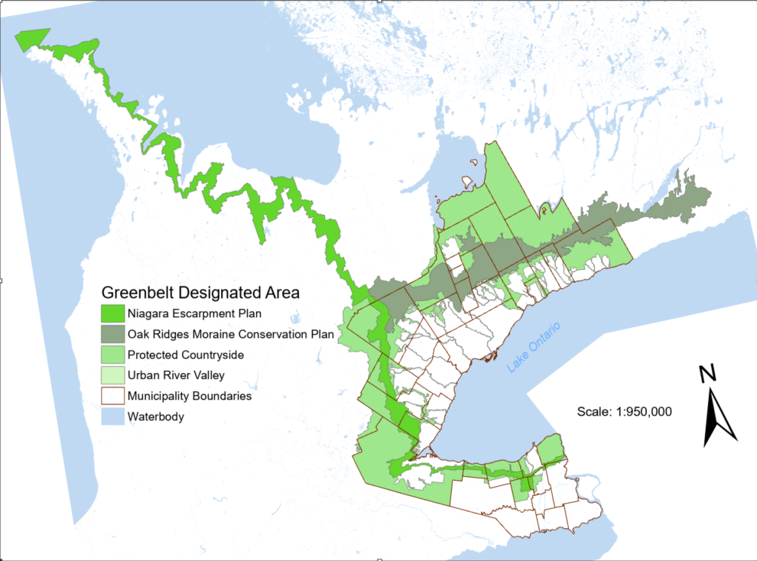
Ontario’s Greenbelt is one of the largest in the world, protecting natural and agricultural lands in the Niagara Escarpment, the Oak Ridges Moraine, and the protected countryside within the Greenbelt, as well as numerous urban river valleys flowing from the Greenbelt to Lake Ontario.
BACKGROUND

Slide 7
Issues where development can negatively impact areas both within and outside
of the Greenbelt include:
Settlement growth and new infrastructure inside the Greenbelt;
Leapfrog development, generally north of the Greenbelt; and,
Over-development of the Contested Countryside - land between existing urban areas above Lake Ontario and below the southern boundary of the Greenbelt.

Slide 8
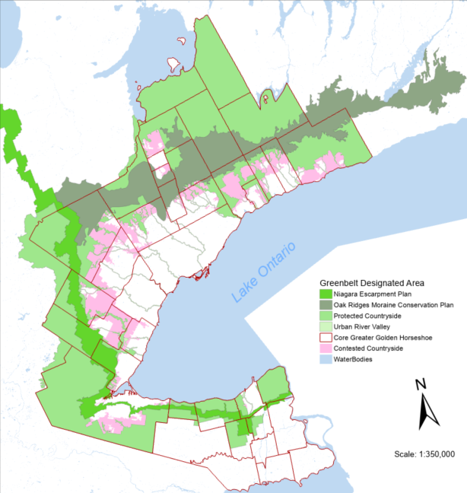
THE CONTESTED
COUNTRYSIDE
The project focused on the third of these potentially negative impacts, the
Contested Countryside, shown here in pink in a drawing that also depicts upper tier municipal boundaries.
The project mapped key features and identified three development scenarios for the future:
Full Urban Build-out;
A Maximum Conservation Approach; &,
The Balanced Approach.

Slide 9
WHAT DO WE MEAN BY CONTESTED?
Competing visions for the Contested Countryside center on protecting ecological goods and services vs converting land and aquatic systems to other uses.
Issues involve free market investment vs protecting lands; sprawl vs density; how to maintain regional ecological integrity; local food security; affordability; complete communities vs long commutes, and more.

Slide 10
ADVERSE OUTCOMES
OF OVER-DEVELOPMENT
Increased urbanization upstream of the already highly-urbanized land in South-central Ontario can:
Disrupt hydrologic integrity, tipping watersheds below healthy conditions;
Reduce natural areas needed for climate resiliency;
Reduce biodiversity;
Reduce local food security; and,
Increase sprawl over complete communities and make mass transit financially impractical

Slide 11
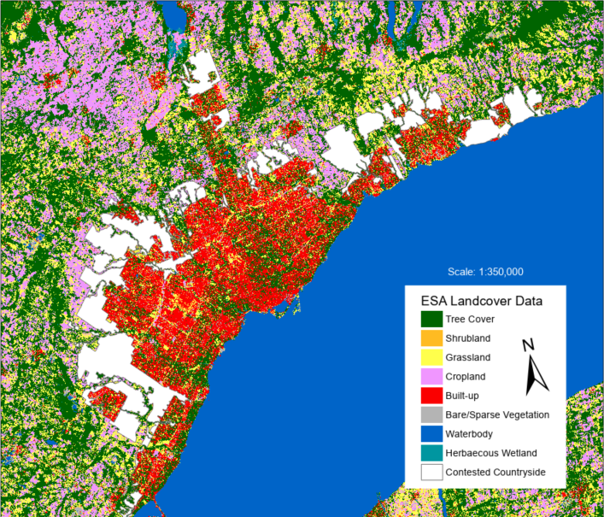
BASELINE FEATURES
This drawing demonstrates the use of data from the European Space Agency to depict baseline features such as urban development, natural areas, and agricultural lands, and shows the Contested Countryside in white.

Slide 12
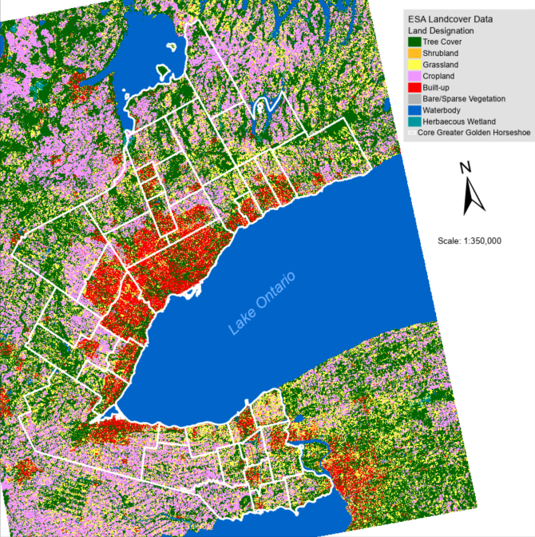
The Contested Countryside
and Municipal Boundaries
This variation of the previous slide shows the boundaries of upper tier municipalities that comprise the Greater Golden Horseshoe.
Areas in pink and green highlight natural and agricultural lands both in and above the Greenbelt, as well as those in the Contested Countryside below the Greenbelt.
Northward migration of the highly urbanized areas (shown in red) along existing planning protocols suggest significant negative impact of regional watershed health, natural heritage, and food security.

Slide 13
Development Scenarios for the Contested Countryside
Using a series of indicators and a scoring system, students at Fleming postulated three development scenarios for the future of the Contested Countryside, with implications for the region’s ecological, social, and economic vitality.
Access to detailed mapping and explanations of Fleming Team’s Multi-criteria Decision Analysis for the three scenarios are available at
https://ontarioheadwaters.github.io/ContestedCountryside/ESUWebMapCC.html.

Slide 14
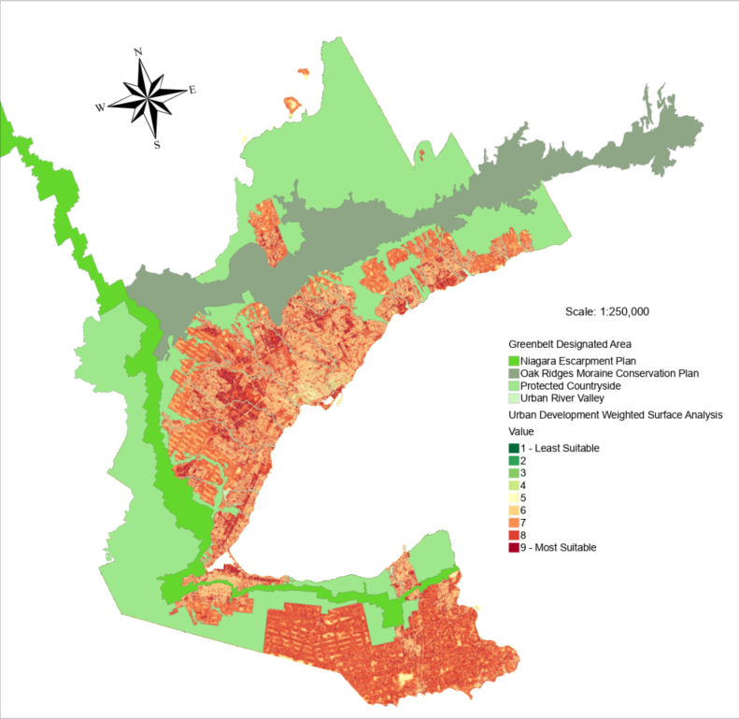
Scenario 1:
Full Urban Build-out
This scenario applied few constraints in the Multi-criteria Decision Analysis to protect natural and agricultural land in the Contested Countryside.
The scenario would result in 87% coverage of the Contested Countryside in residential, commercial and infrastructure development, leaving 13% for natural and agricultural lands.

Slide 15
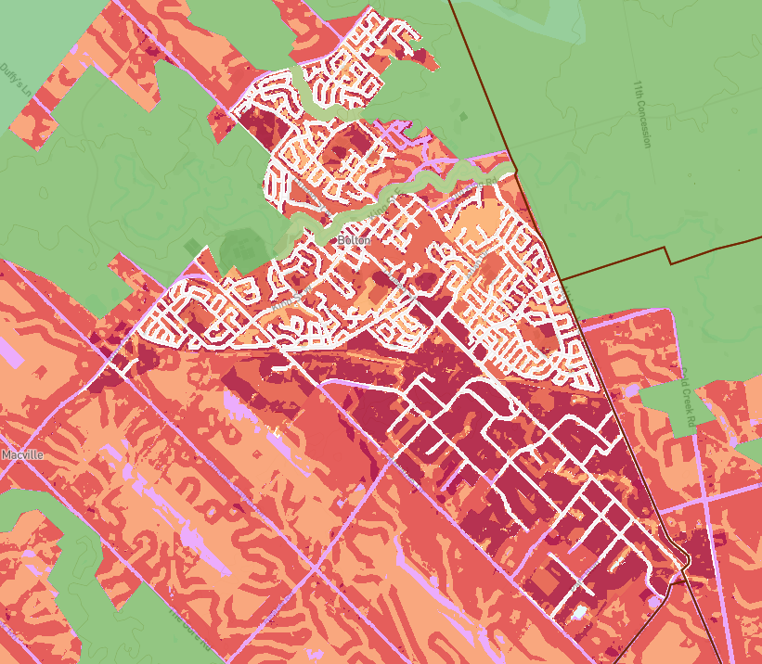
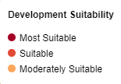
Scenario 1:
Full Urban Build-out
Magnification near Bolton
Full build-out in this area shows remnant patches of the Contested Countryside in pink.
The large areas in green are the Greenbelt, while viewers may also notice a minor anomaly – explained in the website FAQs - that shows some but not all roads also in pink.
You can magnify this and other areas in this scenario at https://ontarioheadwaters.github.io/ContestedCountryside/ESUWebMapCC.html.

Slide 16
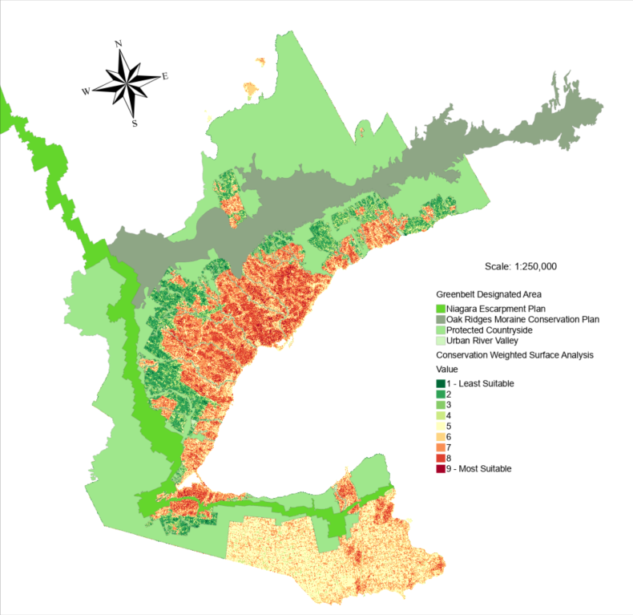
Scenario 1I:
Maximum Conservation Approach
This scenario is the opposite of full build-out, applying the Fleming Team’s Multi-criteria Decision Analysis to protect all highly-valued natural and agricultural land in the Contested Countryside with suitable buffers.
This scenario would protect 98.43% of the area’s natural and agricultural land, leaving 1.57% of the Contested Countryside for residential, commercial and infrastructure development,

Slide 17
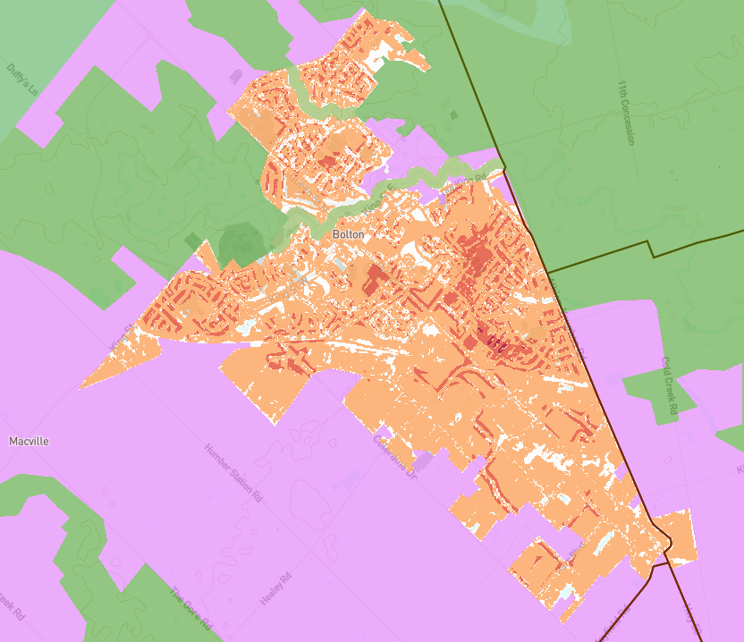
Scenario II:
Maximum Conservation Approach
Magnification near Bolton
This scenario retains much of the Contested Countryside around Bolton, in pink, while the orange areas denote land that is only moderately suitable for urbanization.
You can magnify this and other areas in this scenario at https://ontarioheadwaters.github.io/ContestedCountryside/ESUWebMapCC.html.

Slide 18
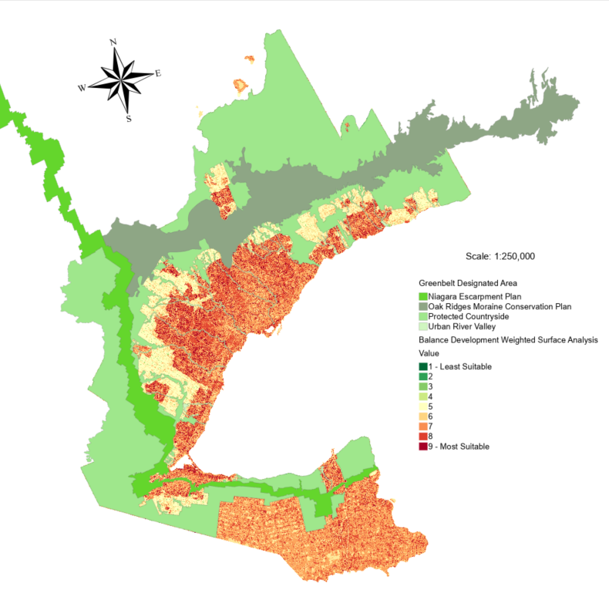
Scenario III:
The Balanced Approach
As the name suggests, this scenario uses the Multi-criteria Decision Analysis to strike a balance that would enable dense urbanization where appropriate while protecting the most important natural and agricultural lands across the Contested Countryside.
This scenario would result in 7.79% coverage of the Contested Countryside in residential, commercial and infrastructure development, leaving 92.21% for natural and agricultural land.

Slide 19
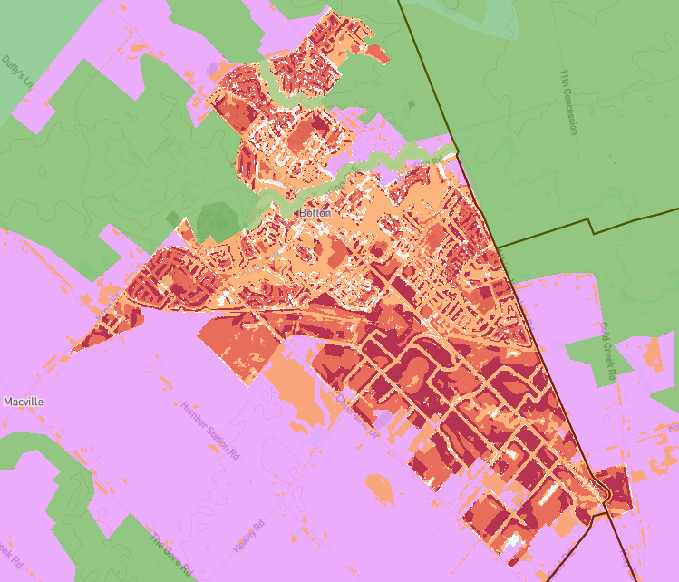
Scenario III:
The Balanced Approach
Magnification near Bolton
This scenario increases the suitability of some of the orange areas outside of the existing town core in the previous scenario to accommodate increased urbanization while also retaining the bulk of the natural and agricultural lands in the Contested Countryside.
You can magnify this and other areas in this scenario at https://ontarioheadwaters.github.io/ContestedCountryside/ESUWebMapCC.html.

Slide 20
Issue Summary:
Full Urban Build-out
The OHI believes that the full build-out of the Contested Countryside along current planning protocols would likely:
Push the health of our watersheds beyond tipping points for ecological integrity;
Disrupt social and economic norms;
Under-address the need for action on climate resilience; and,
Reduce local food security in an age of climate extremes, reduced water availability, and increased costs for food production and its transportation.

Slide 21
Issue Summary:
Maximum Conservation
Swinging the pendulum in the opposite direction from the Full Urban Build-out, the Maximum Conservation Approach would protect what has become the remaining headwater reservoirs of many watersheds.
Downstream, these watershed are over-developed, with polluted water, fragmented natural heritage, and reduced agricultural lands.
Similar over-development in the headwater areas could tip whole watersheds into severely degraded conditions.

Slide 22
Issue Summary:
The Balanced Approach
The Balanced Approach identifies a path worthy of discussion as municipalities begin to develop more details to implement their new official plans.
It seeks to protect our waters as well as our natural and agricultural lands in our headwater reservoirs for future generations while also earmarking almost 8% of the Contested Countryside to accommodate significant short and mid-term population growth.
In addition.....

Slide 23
Issue Summary:
The Balanced Approach
... As municipalities address short and mid-term growth in the 8% of suitable lands identified in this project, they could also begin to address new protocols needed to address any further growth beyond the 8%.
Measures needed before any further growth should be contemplated include implementing:
The sustainable vision of the Planning Act;
Watershed planning as called for under the Provincial Policy Statement; and,
Municipal protocols that should include Natural Heritage Strategies, Biodiversity Strategies, Green Development Standards, and that address Climate Change.

Slide 24
Research, creating the Multi-criteria Decision Analysis, and cartography for this project was done by students in the Geomatics Institute at Fleming College.
We thank the Institute, the faculty who provided technical direction and guidance, and the students:
Prashant Balachandar
Colin Chappell, and
Jenish Shaleenkumar Shah
Interpretation of the mapping, policy positions, and text in the slide deck are the responsibility of the Ontario Headwaters Institute.

Slide 25
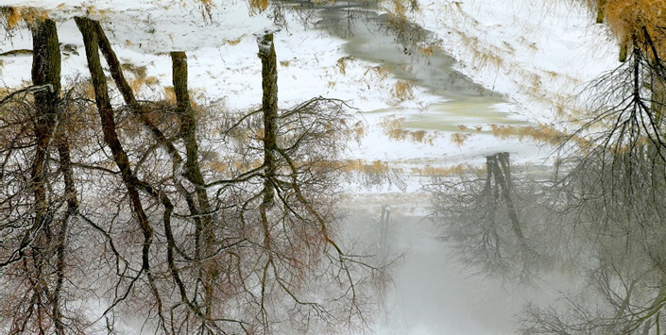

THANK YOU
www.ontarioheadwaters.ca
andrew@ontarioheadwaters.ca
416 231 9484

